Slide 1
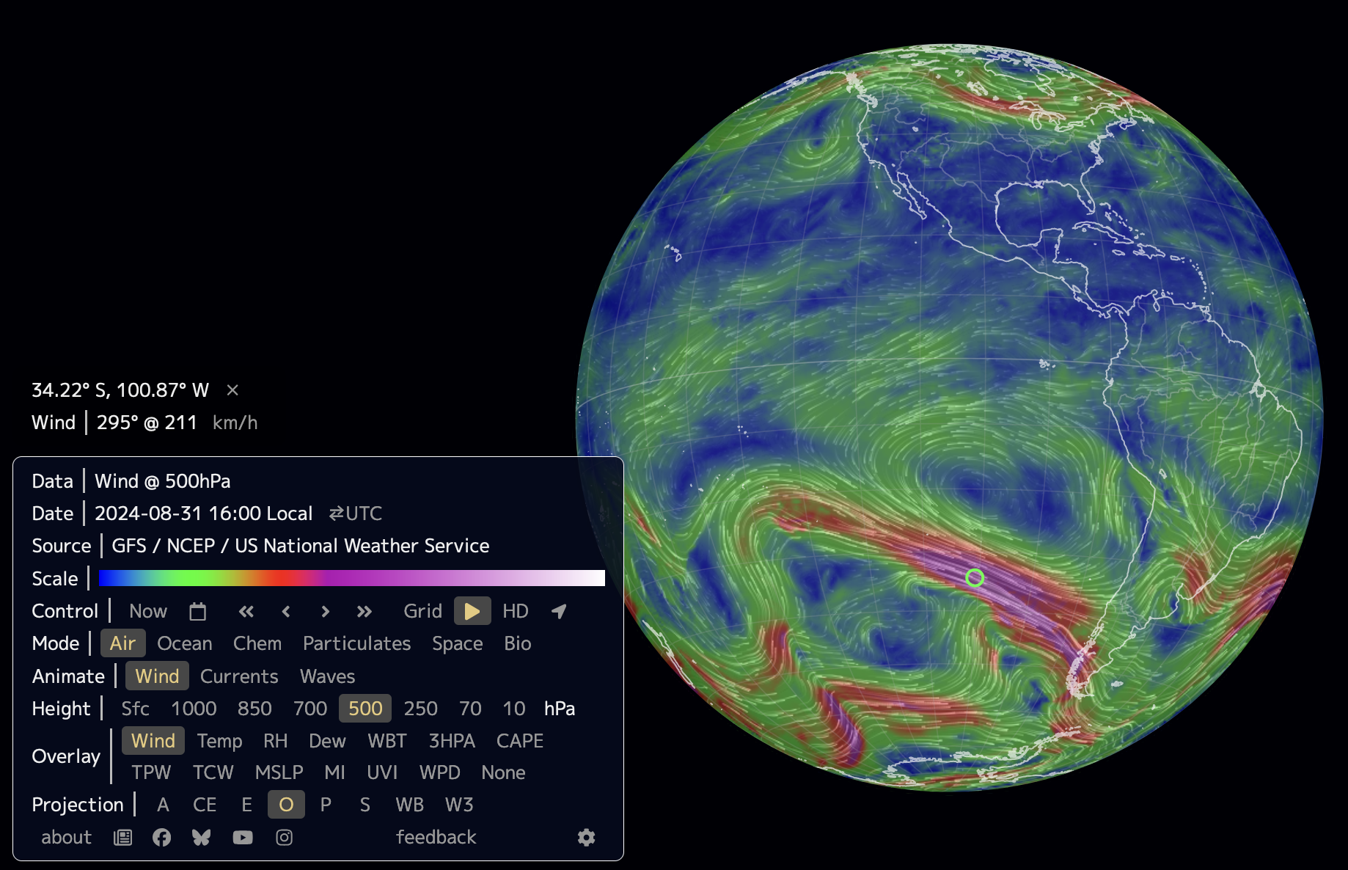
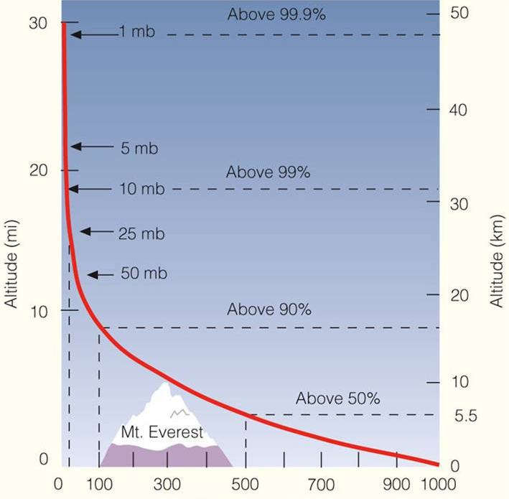

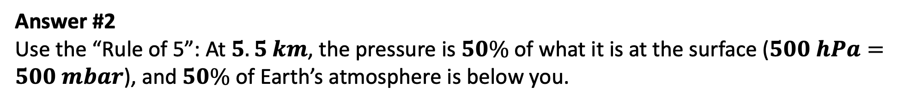
In Earth.nullschool.net, we can change the “height,” but the numbers are in pressure units …
Answer #1 Use a barometric chart.
Question: How does the pressure tell us the height?

Slide 2
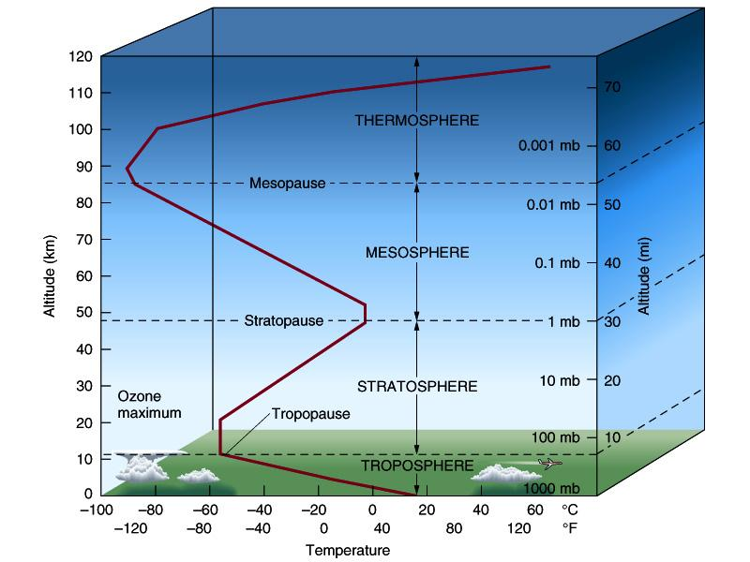
The troposphere and the stratosphere
The troposphere and the stratosphere are defined by turnarounds in the temperature.
Notes:
Tropo means change
Troposphere is heated by the earth and experiences a decrease in pressure (adiabatic cooling) with height (ideal gas law) both cause a decrease in temperature
Troposphere contains 75% of total gases and over 99% of water vapor

Slide 3
The troposphere and the stratosphere
The troposphere and the stratosphere are defined by turnarounds in the temperature.
The troposphere is where most of the weather and climate takes place.

Slide 4
The troposphere and the stratosphere
The troposphere and the stratosphere are defined by turnarounds in the temperature.
The troposphere is where most of the weather and climate takes place.
Just below the top of the stratosphere is the ozone layer.
Notes:
Ozone layer absorbs and converts UV radiation to heat, formation of ozone is also an exothermic (heat creating) reaction energized by UV light

Slide 5
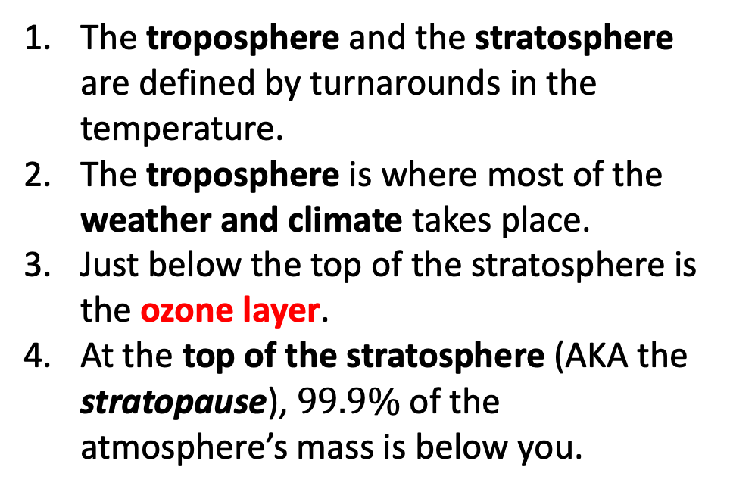
The troposphere and the stratosphere

Slide 6
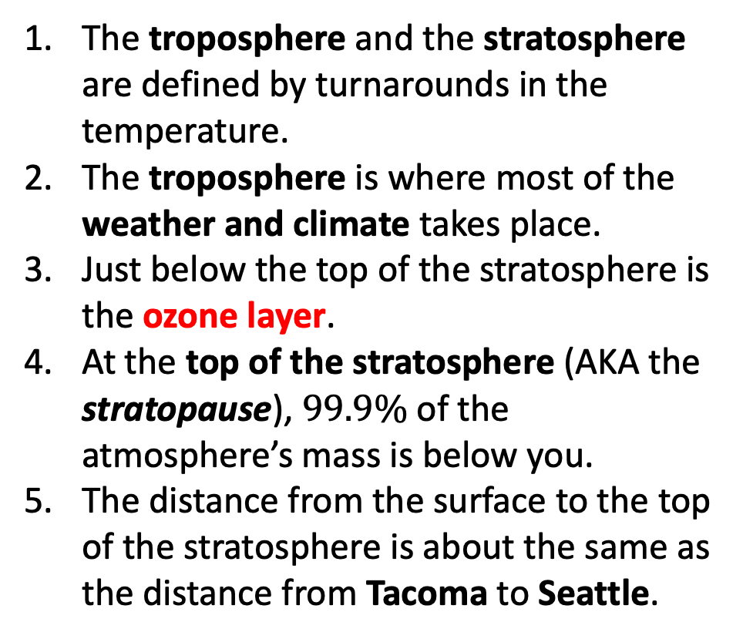
The troposphere and the stratosphere
Tacoma
Seattle

